Slide 1
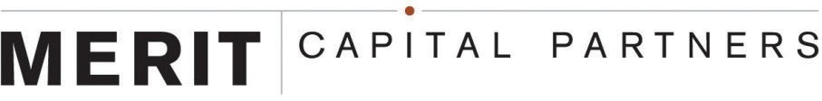

Experienced Partner Providing Flexible Capital
LONG-TERM SUCCESSFUL TRACK RECORD
FLEXIBLE CAPITAL
Merit Capital Partners, headquartered in Chicago, has managed approximately $2.5 billion of capital since its inception in 1993. Merit partners with founders, management teams, owners, and independent sponsors, handling the entire investment process and providing all the necessary capital for its transactions.
Investment Profile
TRANSACTIONS
Management Buyouts, Majority and Minority Recapitalizations, Acquisition Financings, Shareholder Liquidity Events, Growth Financings, and ESOPs
INVESTMENT SIZE
At least $20 million
When to Think of Merit Capital Partners
INDUSTRIES
Manufacturing, distribution, logistics, and service businesses
INDEPENDENT SPONSORS-LED INVESTMENTS
RECAPITALIZATIONS (MAJORITY AND MINORITY)
GROWTH/ACQUISITION FINANCINGS
SHAREHOLDER LIQUIDITY & FAMILY TRANSITIONS
MANAGEMENT BUYOUTS
EBITDA of at least $4 million, no minimum for add-ons
COMPANY SIZE
STRUCTURE
Combination of majority/minority equity and subordinated debt
INVOLVEMENT
Serve as board-level advisors rather than day-to-day managers
NOT CONSIDERED
Start-ups, turnarounds, real estate financings, specialty retailers, oil, and gas opportunities
Thomas Campion | John Darguzas | Bill Floyd |Evan Gallinson | Brian Heck |Alec Hutcherson | Jack McKerr |
Dan Pansing | Joe Polaneczky | Terry Shipp | Sean Stanley | Marc Walfish | Ben Yarbrough
191 N. Wacker Drive
Suite 1100
Chicago, Illinois 60606
Tel: 312/592-6111
meritcapital.com

Slide 2

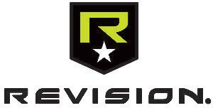


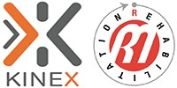













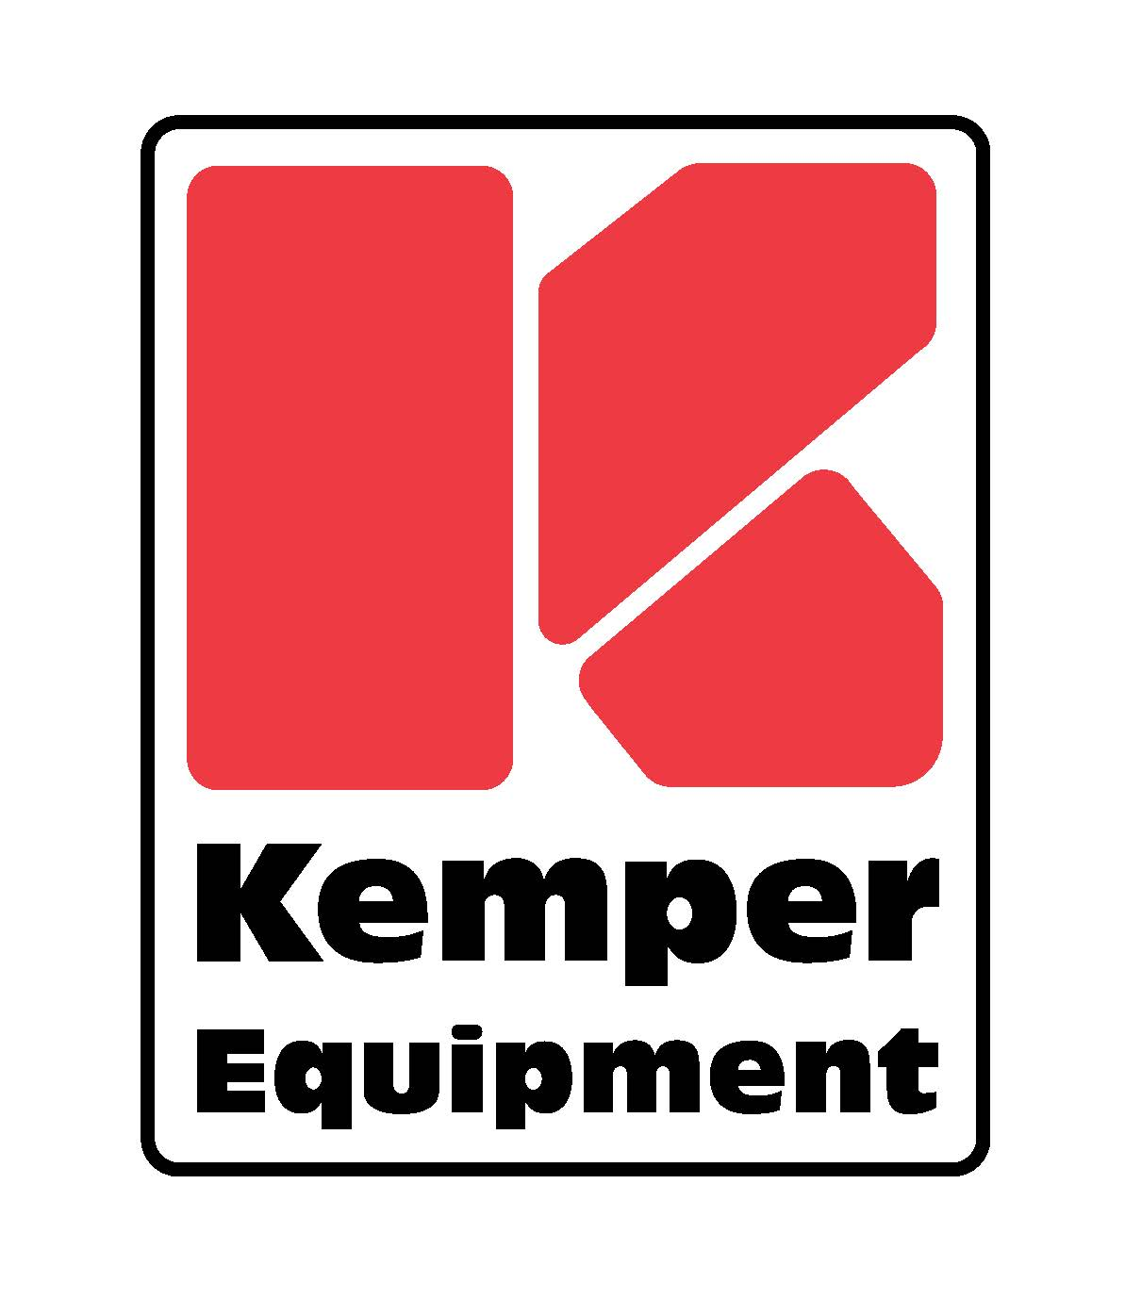
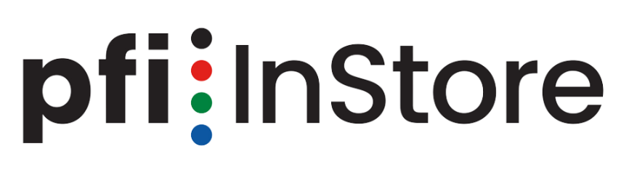
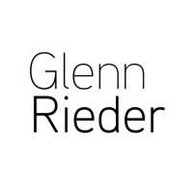


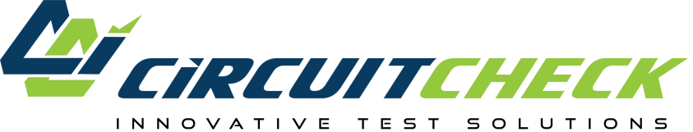
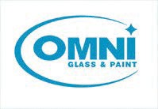


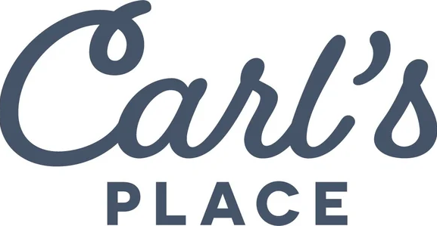
Portfolio as of February 2025
Representative Portfolio
U.S Minerals
Recycler and processor of industrial minerals for the abrasives and roofing industries.
Tinley Park, Illinois
Revision
Manufacturer of ballistic and laser protective eyewear.
Essex, Vermont
Glunt Industries
Repairs and refurbishes equipment for the steel, aluminum, and pipemill industries.
Warren, Ohio
John-Richard
Designer and manufacturer of high-end home furnishings.
Highpoint, North Carolina
Kinex Medical Company And R&M Rehabilitation
Provider of post-operative orthopedic rehabilitation products and services.
Waukesha, Wisconsin
Propét Footwear
Supplier of comfort footwear products.
Auburn, Washington
Identity Group
Designer and manufacturer of custom identity products and wayfinding services.
Nashville, Tennessee
Urban Surfaces
Distributor of flooring products.
Corona, California
Advantaged Sintered Metals & Contact Technologies
Designer and manufacturer of powder metal parts.
St. Marys, Pennsylvania
GoodGiant
Full-service, integrated marketing agency.
Mobile, Alabama
Medway Air Ambulance
Provider of fixed-wing medical air transport services.
Lawrenceville, Georgia
CyCan Industries
Developer and manufacturer of adhesives, cleaners, lubricants, fragrances, and coatings.
Woodstock, Georgia
Nester Hosiery
Designer and manufacturer of high performance outdoor wool socks.
Mt. Airy, North Carolina
Acacia
Provider of home health, hospice, and palliative services.
Orange County, California
Gartner
Designer of various stationery and gift products for sale to mass merchants, online, and other retailers.
Stillwater, Minnesota
Displayit, Inc.
Designer, manufacturer, and installer of custom structural branded solutions.
Irvine, California
Stratus
Provider of in-home neuro-diagnostic testing services.
Irving, Texas
American Producers Supply
Distributor of industrial and construction related
products.
Marietta, Ohio
Reliant
Provider of home healthcare and hospice care services.
Allen, Texas
Kemper Equipment
Designer, manufacturer, and assembler of aggregate
processing equipment.
Honey Brook, Pennsylvania
MW Metals Group
Provider of industrial scrap management services.
Dayton, Ohio
PFI
Provider of retail display solutions.
St. Louis, Missouri
Glenn Rieder
Manufacturer and installer of custom architectural millwork.
West Allis, Wisconsin
AFX
Designer and distributor of decorative and commercial lighting solutions.
Waukegan, Illinois
MicroPrecision
Manufacturer of precision machined parts.
Delavan, Wisconsin
Circuit Check
Designer and manufacturer of custom test systems and test fixtures for electronics.
Maple Grove, Minnesota
Omni Glass & Paint
Provider of glass and paint related products and services.
Oshkosh, Wisconsin
Kish
Distributor and processor of industrial minerals.
Cleveland, Ohio
Elgen
Engineer and manufacturer of ductwork accessory products.
Closter, New Jersey
Carl’s Place
Manufacturer and distributor of golf simulator kits and components.
Milton, Wisconsin
This brochure or pamphlet does not constitute any investment advice, any offer to perform investment advisory services or any solicitation or offer to buy or sell any securities. No representation is made about the accuracy or completeness of the information contained in this brochure or pamphlet. Past performance does not guarantee future results. This brochure or pamphlet is confidential, may be proprietary and is intended only for the recipient. Merit Capital disclaims all responsibility from and accepts no liability whatsoever for the consequences of any unauthorized person acting, or refraining from acting, on any information contained in this message.

